Slide 1
Group Members: Anam Yasin Durdana Saleem Meryam sher Tooba Rauf From Samsung Company

Slide 2
Samsung’s galaxy camera
a camera of future

Slide 3
Samsung Samsung Galaxy Camera GC100

Slide 4
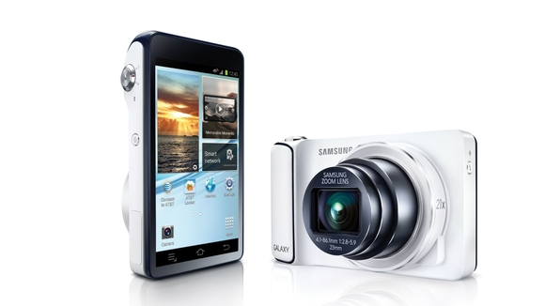
A smart camera: a camera with iPod Announced 2012, August

Slide 5
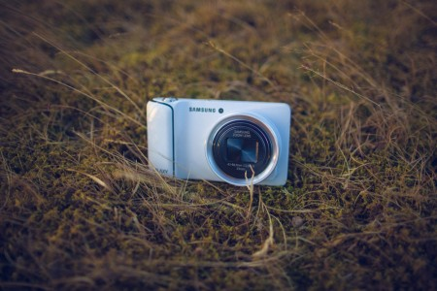
n OK camera, but a very good gadget
Samsung Galaxy Camera GC100
Device with no support for GSM voice communication.

Slide 6
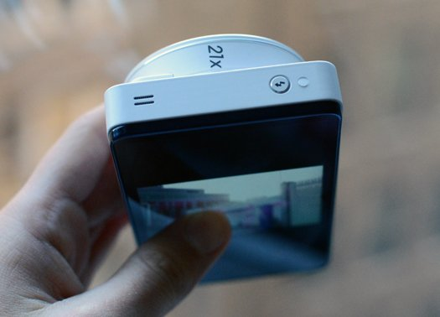
Slimmest camera

Slide 7
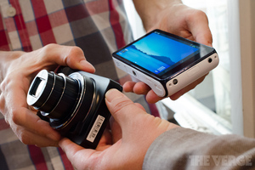
Features
720 x 1280 pixels, 4.8 inches - CPU :1 GB RAM - 8 GB storage - Bluetooth, Wi-Fi connectivity - 16 MP camera - Android OS, v4.1 (Jelly Bean) - Quad-core 1.4 GHz Cortex-A9
Browser : HTML 5
Battery : Talk time=4h 30min, standby=168h
Dimension : 129 x 71 x 19mm
http://www.gsmarena.com/samsung_galaxy_camera_gc100-4961.php

Slide 8
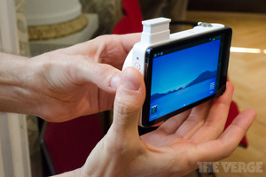
Features 1. Wireless 2. Speaker , Microphone 3. Sensors: Accelerometer, gyro, compass 4. Messaging :SMS, MMS, Email, Push mail, IM, RSS. 5. GPS support. 6. Java MIDP emulator. 7. camera : photo, video
http://www.gsmarena.com/samsung_galaxy_camera_gc100-4961.php

Slide 9
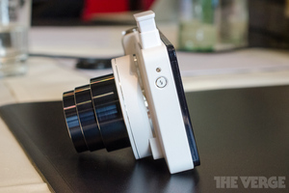
Body type Body type: Compact Weight : 300g Camera 16.3 MP, 4608×3456 pixels, autofocus, 21x optical zoom… …flash, AF light, check quality

Slide 10
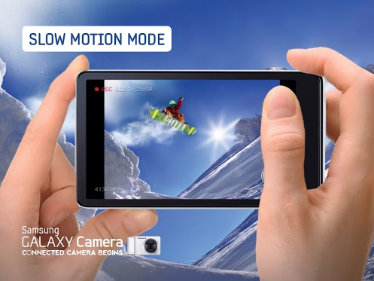
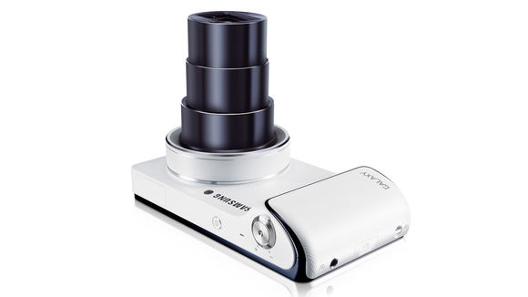
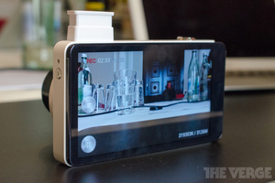
Optics & Focus Focal length : 23 – 481 mm Optical zoom : 20.9× Video : in slow motion too

Slide 11
Samsung Galaxy Camera specifications
Photography features
Scene modes | Macro Rich Tone Action Freeze Waterfall Trace Light Trace Beautiful Sunset Blue Sky Natural Green Silhouette Vivid Fireworks

Slide 12
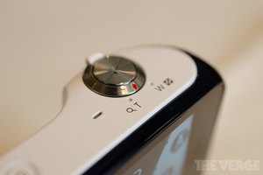
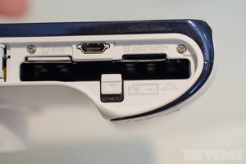
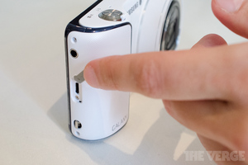
Special Buttons and ports.

Slide 13
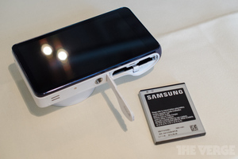
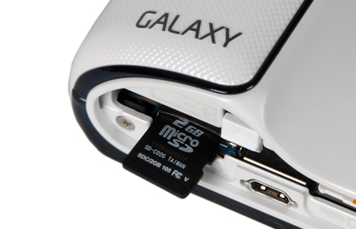
Battery and memory card Port

Slide 14
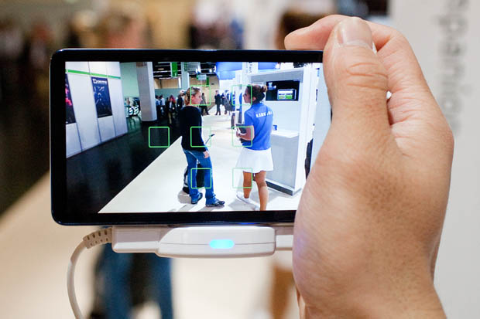
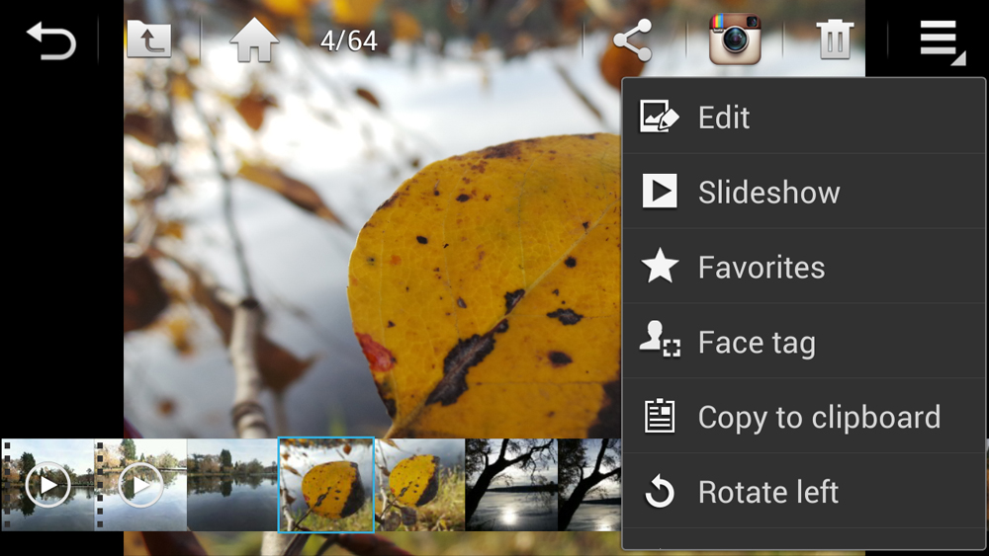
Screen / viewfinder Articulated LCD : Fixed Screen size:4.8" Touch screen : Yes Screen type 308 pipe, HD Super Clear Touch Display

Slide 15
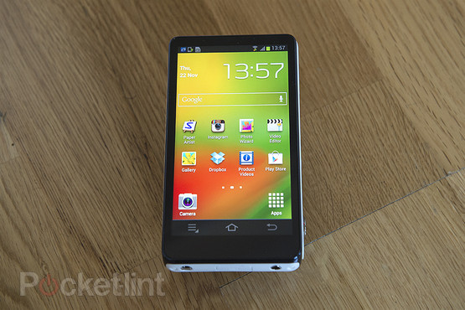
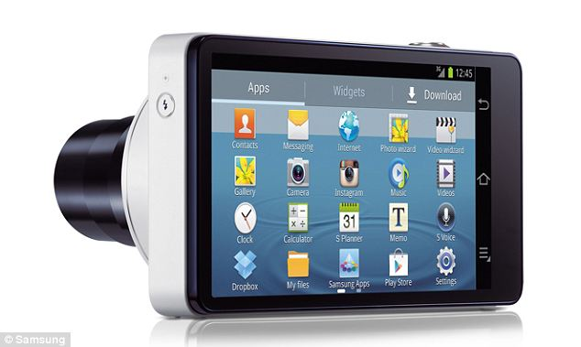
Manu
1. on the device 2. click on camera from menu.

Slide 16
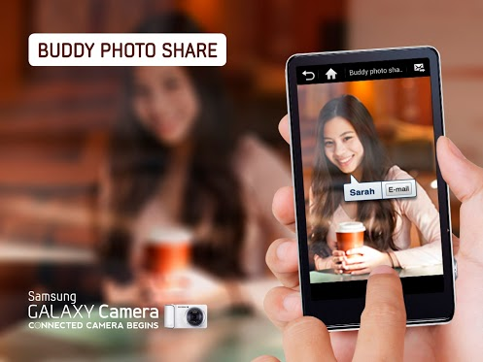
3. take a picture ,change size color 4. share it with others.
touch focus, face and smile
5. you can also comment on other pictures.

Slide 17
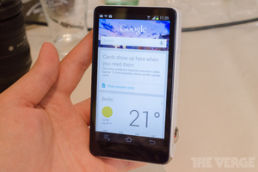
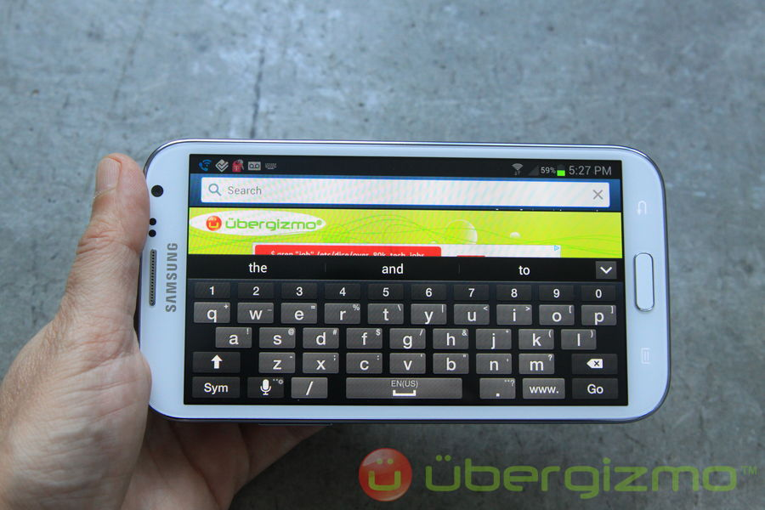
Options: 6. use internet on it. This is a device with HD camera and complete computer operating system.

Slide 18
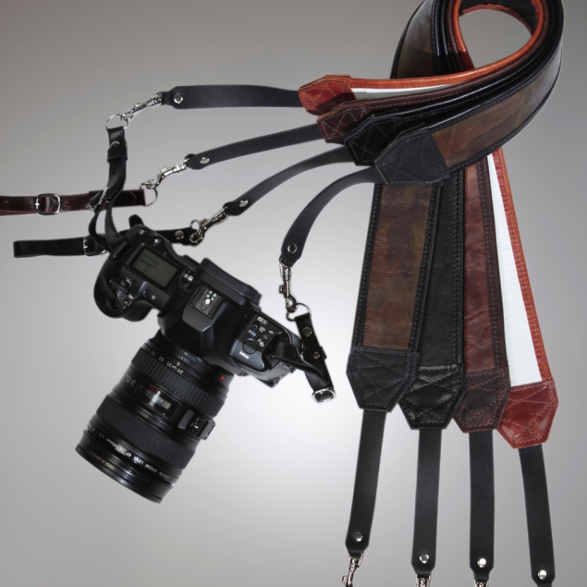
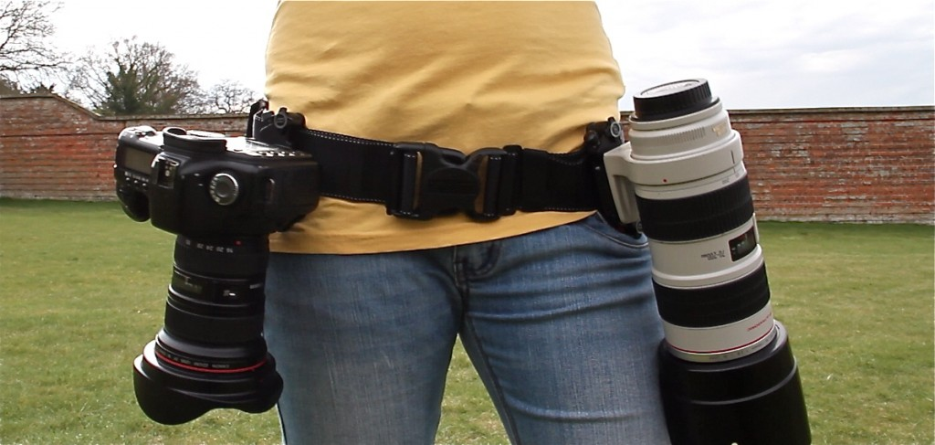
Stop worrying about heavy cameras

Slide 19
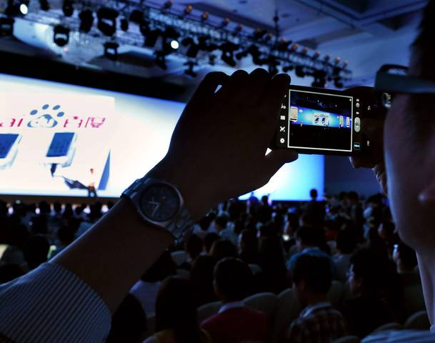
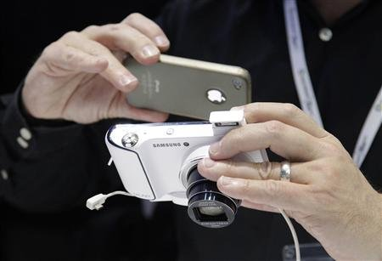
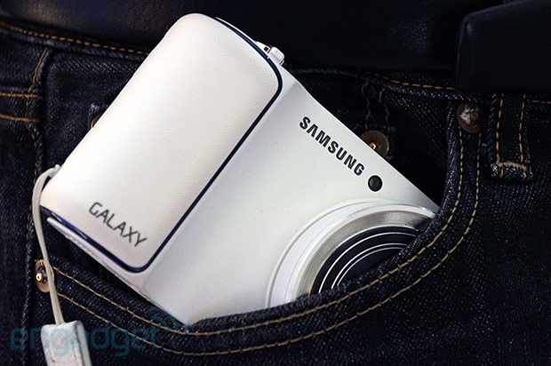
Samsung brings slimmest camera of the age
Can make movies in dark.
In a pocket

Slide 20
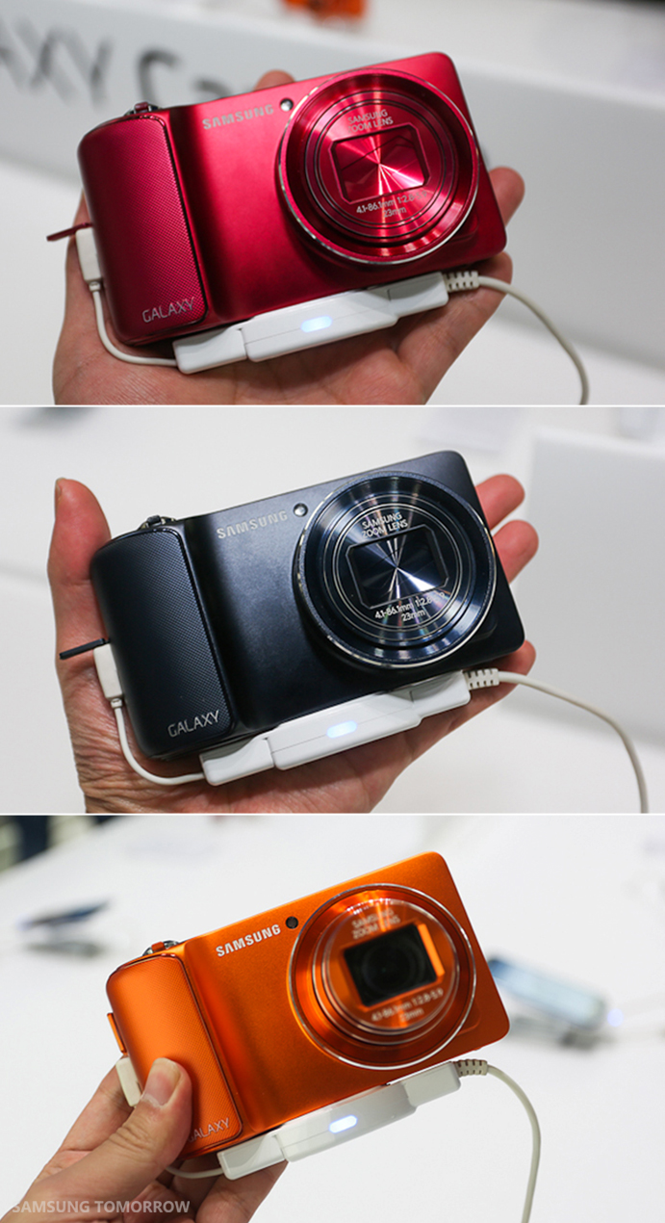
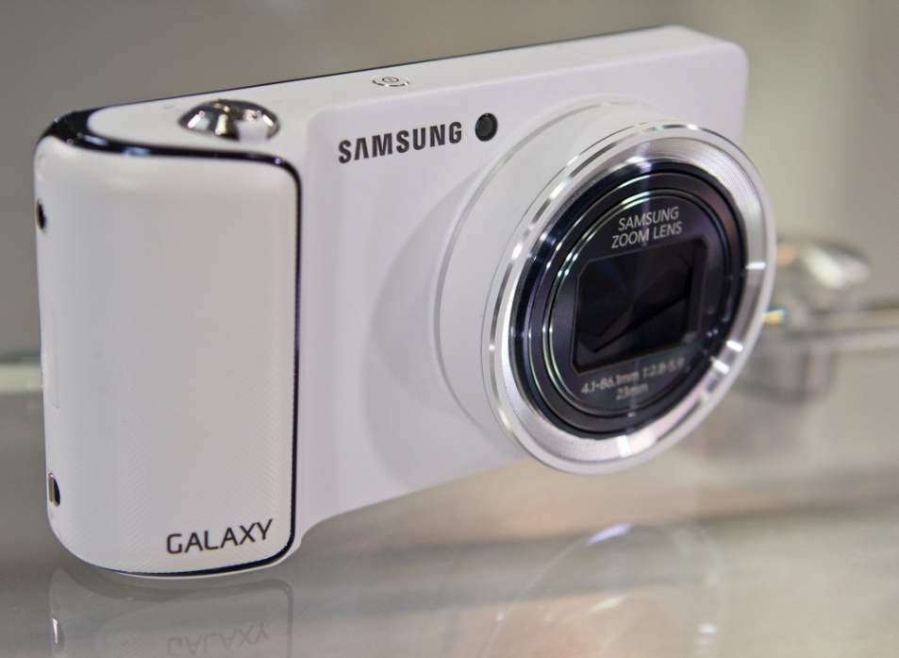
You can find different colors:
From Google images

Slide 21
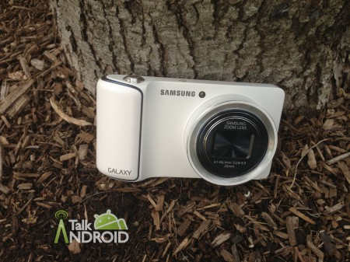
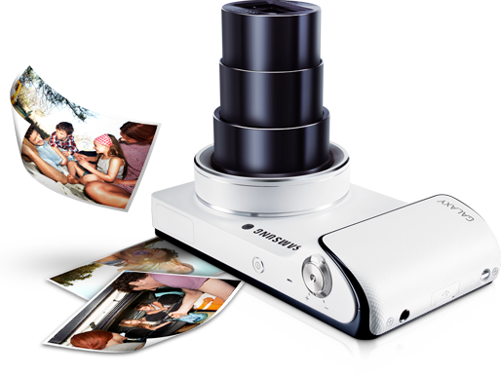
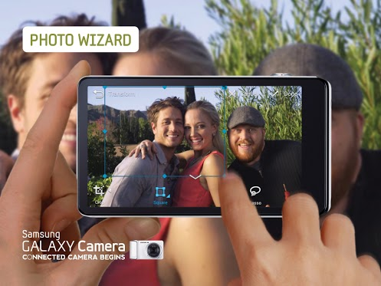
Enjoy your life:

Slide 22
You can capture beautiful moments of your life with this camera. Thank you

