Slide 1
Enhancing Opportunities For collaborative Learning
Folk tales for collaborative learning
Learning about communities

Slide 2
Folktale for collaborative learning
What is folktales?
A folktales is a story or legened forming of an oral tradition .
Folktales show our traditions
Folktales show our custom
Old history incedent

Slide 3
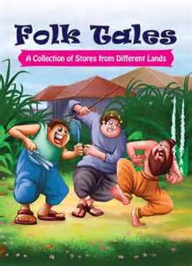
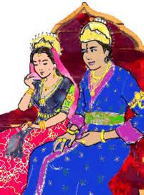
Picture of folktales

Slide 4
Characteristces
Oral storytelling
Straight forwarding
Include magic and superpower
They includes as a good or bad qualities
They includes wisdom,foolishness
Ending usually happy and satisfying
They help in every subject (pak study,english)
Moral lesson
Character bilding

Slide 5
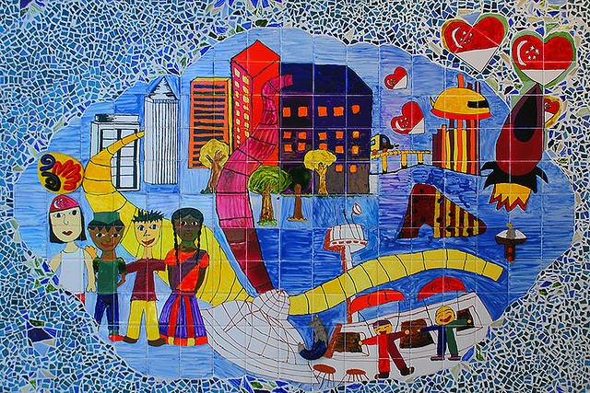
Learning about communities

Slide 6
What is community
A community is a group of people who share common emotions,
values or beliefs,
actively engaged in learning together from each other,
and by habituation.
they can share the problem with each others

Slide 7
Learning community models
Learning communities can take many forms.
The learning community approach fundamentally restructures the curriculum, and the time and space of students.
Many different curricular restructuring models are being used, but all of the learning community models intentionally link together courses or coursework to provide greater curricular coherence, more opportunities for active teaming, and interaction between students and faculty

Slide 8
Results of learning communities
Universities are often drawn to learning communities because research has shown that they improve student retention rates.
learning community can have a much greater impact on students
The camaraderie of co-enrollment may help students stay in school longer, but learning communities can offer more: curricular coherence; integrative, high-quality learning; collaborative knowledge-construction; and skills and knowledge relevant to living in a complex, messy, diverse world.
Studies show that enrollment in a learning community has a powerful
They effect on student learning and achievement
They can easily solve the problem and commuinte with others

